Slide 1



Adichunchanagiri Institute of Technology Chikkamagaluru - 577102 Dept. of CS&E ( DATA SCIENCE)
Mini Project – Presentation on
“Study Planner And Organiser”
(STAY ORGANIZED AND STAY FOCUSED.)
Presented by: Under the Guidance of:
DEVIKARANI S K (4AI22CD017) Prof. Pallavi C S
AISHWARYA T K (4AI22CD002)
SAMRUDHI T Y (4AI22CD045)
JNANA JYOTHI T S (4AI22CD027)

Slide 2
Problem statement:
Students often struggle with managing tasks and deadlines due to a lack of tailored tools. This study planner offers a centralized platform to organize schedules, track progress, and improve productivity.

Slide 3
Scope of the project:
Purpose: Manage academic schedules, assignments, and study goals.
Features: Customizable timetable, task tracking, reminders, progress analytics.
Integration: Calendar sync, personalized study routines.
Benefits: Streamlined organization, reduced manual effort, better time management.
Scalability: Collaborative features, integration with educational tools.

Slide 4
Project design:
User-Friendly Interface: Intuitive navigation with an interactive dashboard.
Front-End Features: Includes a calendar, task list, and progress tracker for easy task management.
Task Management: Users can add, edit, categorize tasks, set priorities, and schedule reminders.
Back-End Functionality: Data storage, user authentication, and synchronization across devices using a secure database.
Responsive Design: Accessible on desktop platforms, ensuring a seamless experience.
Scalability: Designed to accommodate future features like collaboration tools .

Slide 5
Methodology:
Requirement Analysis: Identify key user needs like task tracking, scheduling, and progress monitoring.
Front-end Development: Build a dynamic interface using HTML, CSS, JavaScript, and React.
Back-end Development: Set up server-side logic with Node.js and a database like MongoDB.
Integration & Testing: Integrate front-end and back-end, then test for bugs and performance.

Slide 6
Implementation:
User Authentication: Implement secure sign-up and login for managing accounts and personal data.
Task Management: Allow users to create, edit, delete tasks, set deadlines, categorize, and assign priorities.
Calendar Integration: Integrate a calendar to visually display tasks, deadlines, and study sessions.
Reminder Notifications: Set up alerts for upcoming deadlines, study sessions, and task reminders.
Data Synchronization: Ensure real-time data syncing across devices for easy access on any platform.

Slide 7
Result:
User Authentication: Implement secure sign-up and login for managing accounts and personal data.
Task Management: Allow users to create, edit, delete tasks, set deadlines, categorize, and assign priorities.
Calendar Integration: Integrate a calendar to visually display tasks, deadlines, and study sessions.
Progress Tracking: Include a progress bar or tracker to monitor task completion and study goals.
Reminder Notifications: Set up alerts for upcoming deadlines, study sessions, and task reminders.
Data Synchronization: Ensure real-time data syncing across devices for easy access on any platform.

Slide 8
Challenges faced:
UI Design: Balancing simplicity and functionality.
Data Sync: Ensuring real-time sync without conflicts.
Task Categorization: Intuitive and clean task prioritization.
Reminder Accuracy: Timely, reliable notifications.
Cross-Platform: Seamless operation across devices/OS.
Scalability: Planning for future growth and features.

Slide 9
Future work:
Collaboration Features: Real-time group study and task-sharing options.
AI Integration: Personalized recommendations and schedule optimization.
Mobile App Development: Dedicated iOS and Android apps for seamless experience.
Analytics Dashboard: Insights into study habits, productivity, and time management.

Slide 10
Conclusion:
The study planner and organizer is a valuable tool for students seeking to enhance their time management, productivity, and academic performance. By providing features like task management, scheduling, reminders, and progress tracking, it helps users stay organized and focused on their study goals.

Slide 11
Github links:
Devikarani S K : https://github.com/devikarani-sk/miniproject1
Aishwarya T K : https://github.com/aishwarya-tk/miniproject1
Samrudhi T Y : https://github.com/SamrudhiTY/Study-Planner-Mini-Project
Jnana Jyothi T S : https://github.com/jnanasahana/Study-planner-organizer-

Slide 12
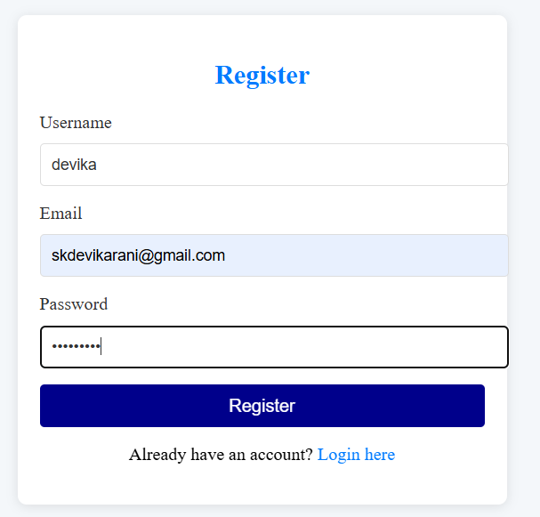
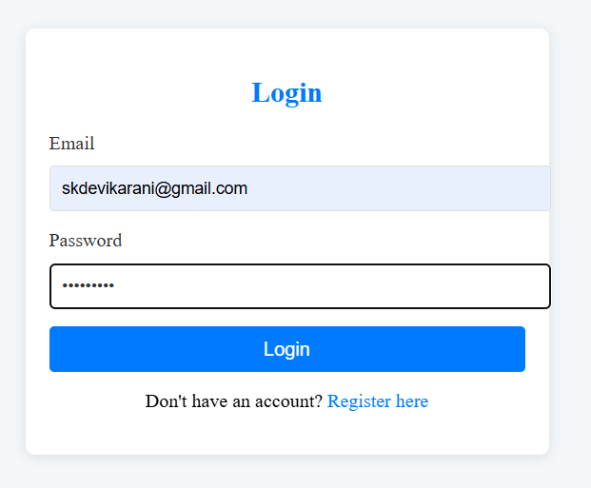
Snapshots:

Slide 13
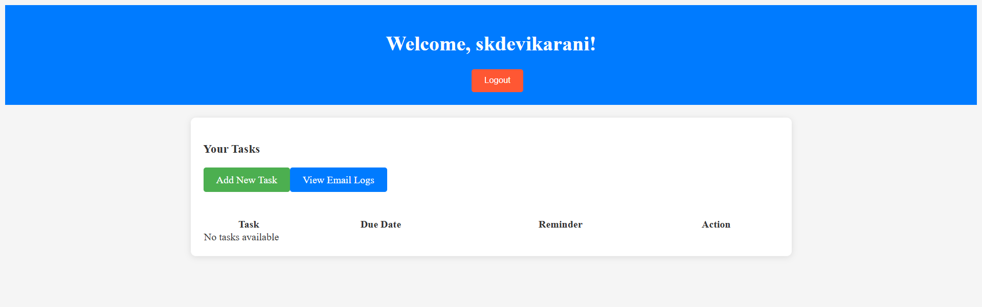
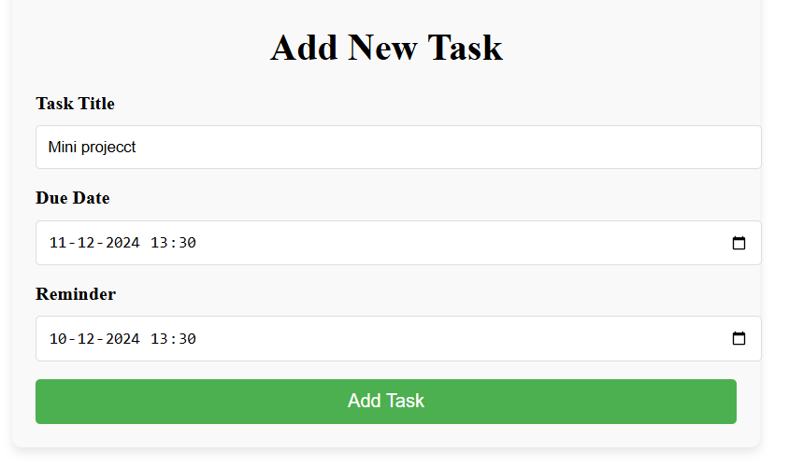

Slide 14
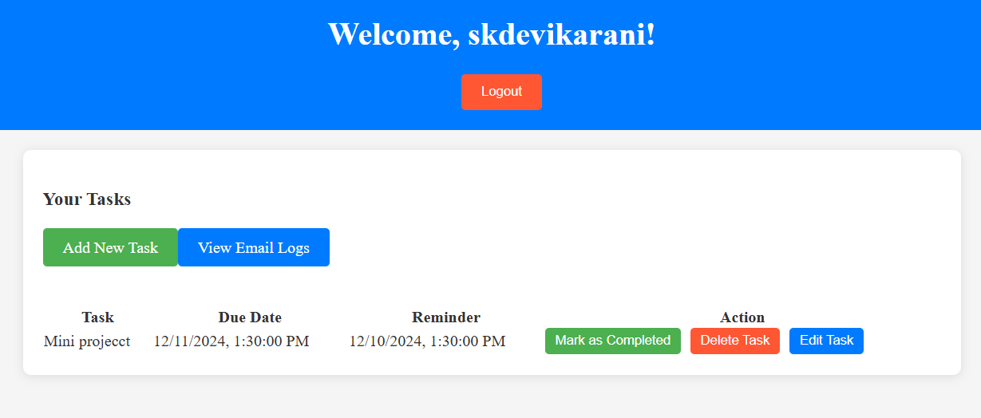

Slide 15
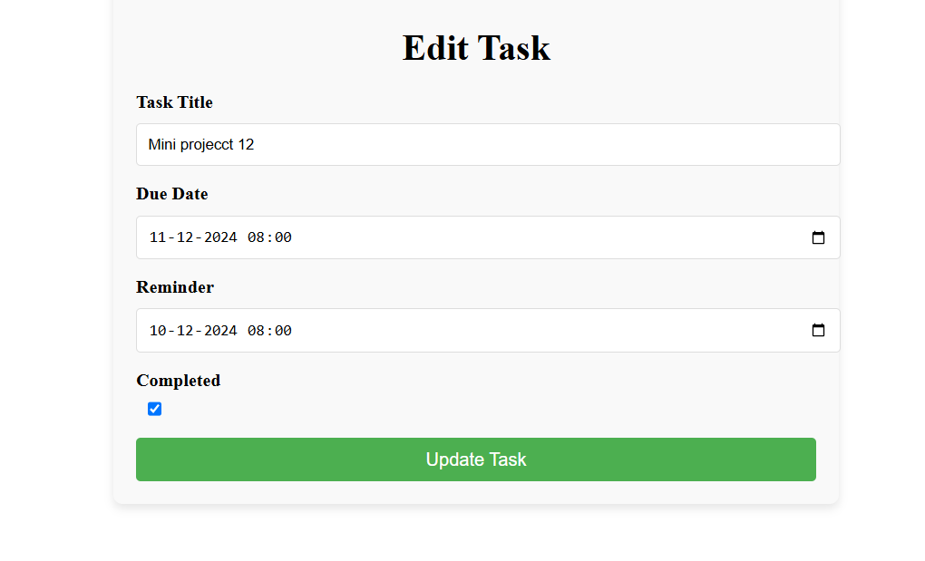
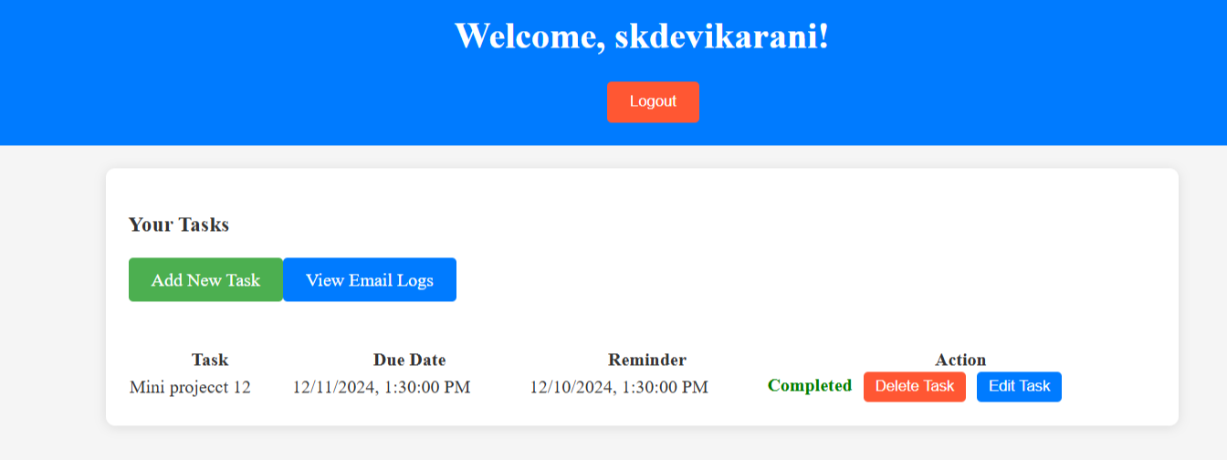

Slide 16
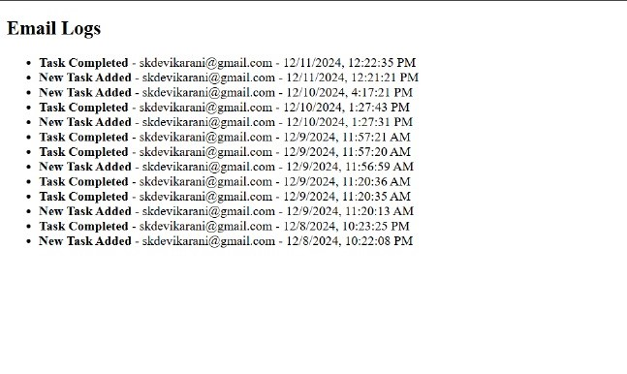

Slide 17
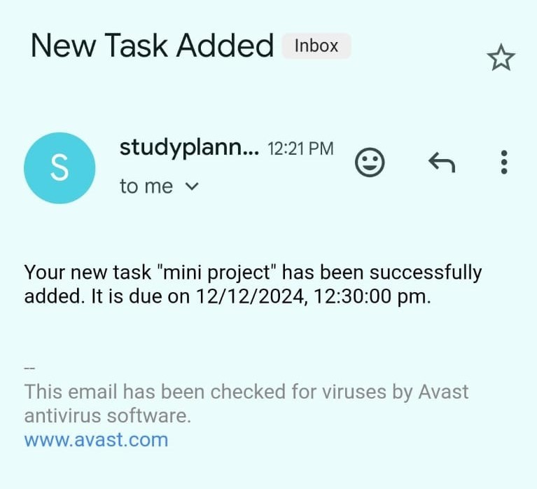
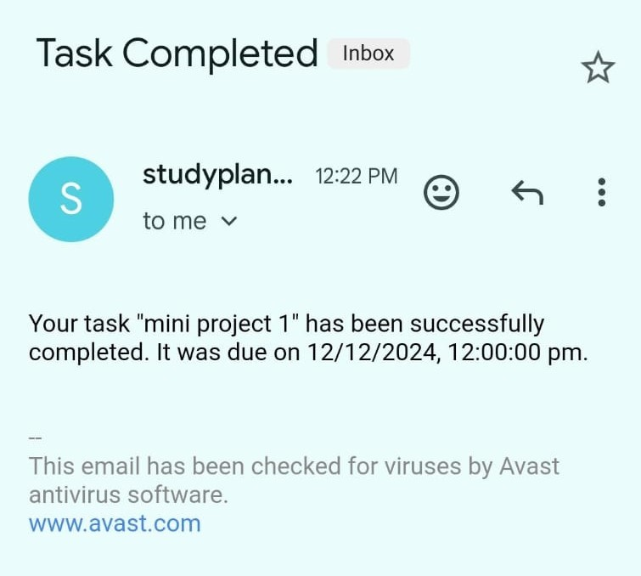

Slide 18

THANK YOU

